Slide 1









Wine quality prediction using machine learning
CREATED BY
Udhaya moorthy.J
3ʳᵈ year – CSE
Reg . No.:912321104050
SACS M.A.V.M.M Engineering college , Madurai.

Slide 2
Outline
Problem statement
Proposed system/solution
System development approaches
Algorithm and deployment
Result
Conclusion
Reference

Slide 3
Problem statement
The objective of this project is to develop a machine learning model that can accurately predict the quality of wine based on various physicochemical properties. The dataset consists of features such as acidity, pH level, alcohol content, and more, which influence the perceived quality of wine.

Slide 4
Proposed system / solution
1.Data Collection:
Gather a diverse dataset containing various attributes of wines such as chemical composition (e.g., fixed acidity, volatile acidity, citric acid), physical properties (e.g., pH, density), and sensory characteristics)
2.Data Preprocessing:
Clean the dataset by handling missing values, removing outliers, and normalizing or scaling the features to ensure uniformity across different scales.
3.Feature Engineering:
Extract meaningful features from the dataset that are highly correlated with wine quality.
4

Slide 5
Proposed system /solution (contd….)
Train the model on a labeled dataset using techniques like mini-batch stochastic gradient descent or Adam optimizer.
Fine-tune pre-trained models (e.g., BERT) on your specific sentiment analysis task to improve performance further.
Assess the model’s performance on a separate validation or test set to ensure it generalizes well to unseen data.
4.Training:
5.Fine Tuning :
6.Evaluation:
5

Slide 6
System Development Approach
Hardware requirements:
1.Sufficient CPU power:
A multi-core processor (e.g., Intel Core i5 or higher, AMD Ryzen 5 or higher) to handle data preprocessing, model training, and prediction tasks efficiently. 2.Ample RAM:
At least 8 GB of RAM, but preferably 16 GB or more, especially if working with larger datasets or complex models to ensure smooth processing and avoid memory-related bottlenecks.
3.Storage:
Sufficient storage space to store datasets, model files, and related resources. A solid-state drive (SSD) is recommended for faster data access and model loading times.

Slide 7
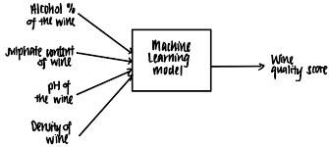
System Development Approach (Contd….)
Software requirements:
Tools and Frameworks:
Popular deep learning libraries like TensorFlow, PyTorch, or Keras can be used for model development.Cloud platforms like Google Colab or provide environments for training and deploying deep learning models.

Slide 8
Algorithm and Deployment
Algorithm:
1.Load the dataset
2.Preprocesses the data by padding sequences to a fixed length
3.Builds a sequential model with an embedding layer
4.Complies the model
5.Trains the model on the training data
6.Evaluates the model on the test data
7.Prints the test accuracy

Slide 9
Algorithm and Deployment (contd….)
Deployment:
Deployment can be done on various platforms, including cloud servers, edge devices.
For deployment on cloud servers,trained model is hosted on a cloud accessed via APIs.
Deployment on edge devices involves optimizing the model for reducing model size.
1
11

Slide 10
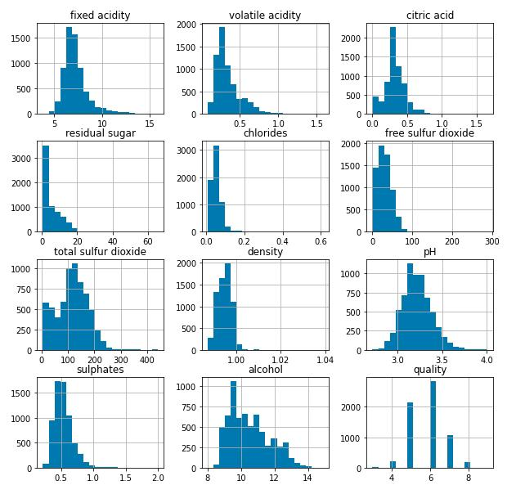
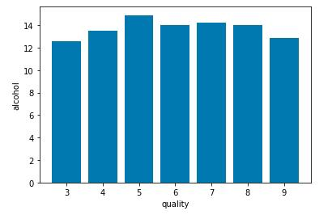
Result

Slide 11
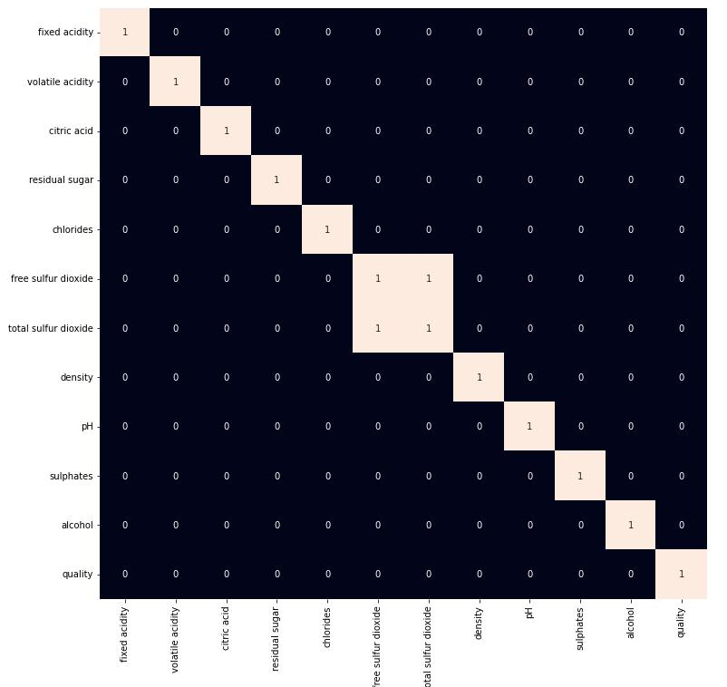
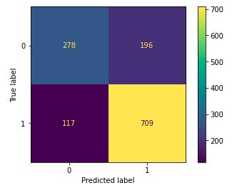
Result (contd….)

Slide 12
Conclusion:
In conclusion,.machine learning models have shown promise in predicting wine quality based on various features such as chemical composition, pH levels, and alcohol content. Through the use of algorithms like Random Forest, Support Vector Machines, or Neural Networks, accurate predictions can be made.

Slide 13
Reference :
https://www.tensorflow.org/
https://numpy.org/
https://scikit-learn.org/stable/
https://keras.io/
https://matplotlib.org/
https://www.geeksforgeeks.org/wine-quality-prediction-machine-learning/amp/

Slide 14


